Slide 1


Report by Yaswanth

Slide 2
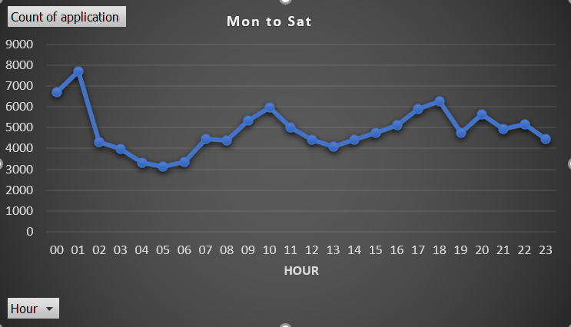
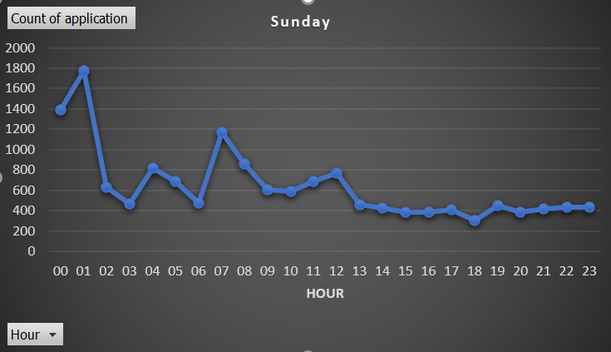
Between 4a.m to 6a.m, the number of applications from Monday to Saturday is at the lowest point of the day.
On Sunday from 1p.m onwards the number of applications are at its lowest point

Slide 3
‘Application’ is always missing for ‘node’ 6 and category 7
On Saturday 'Category’ is always missing for 'application' 102 and 'node' 56
The number of applications, node names and categories are very high at lower values.

